Slide 1
Chapter 2 figures

Slide 2
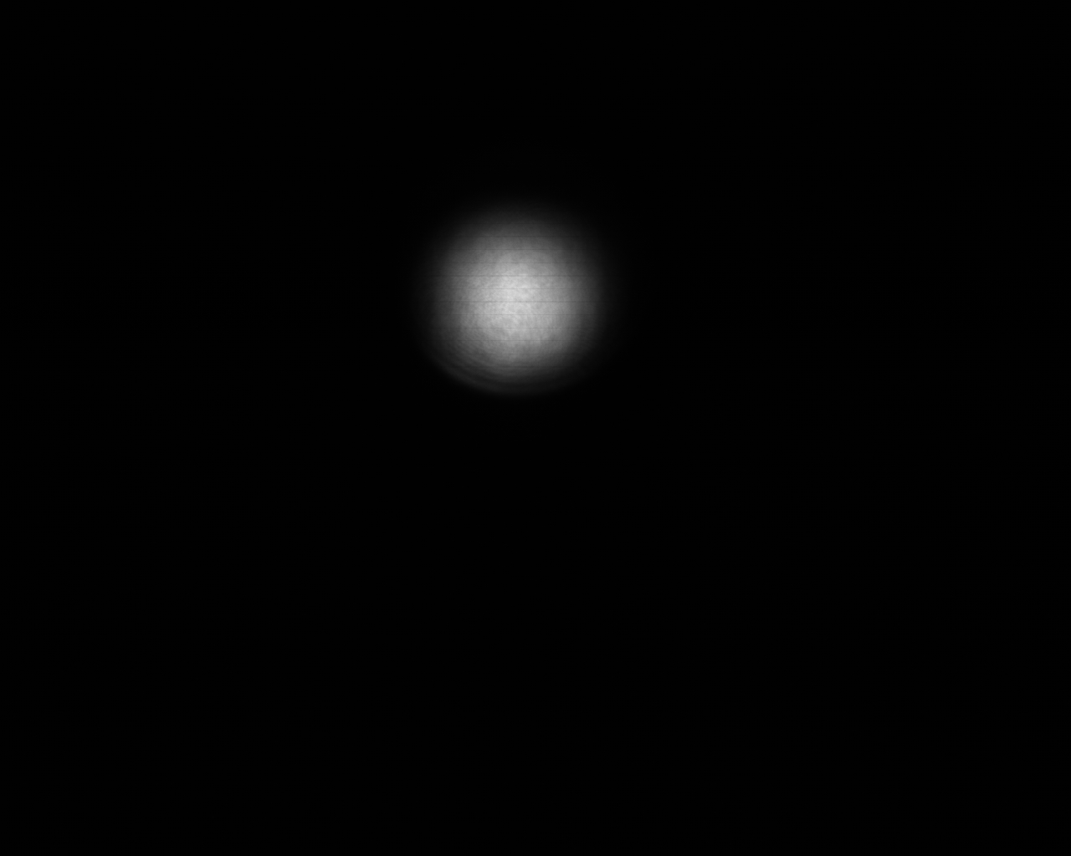
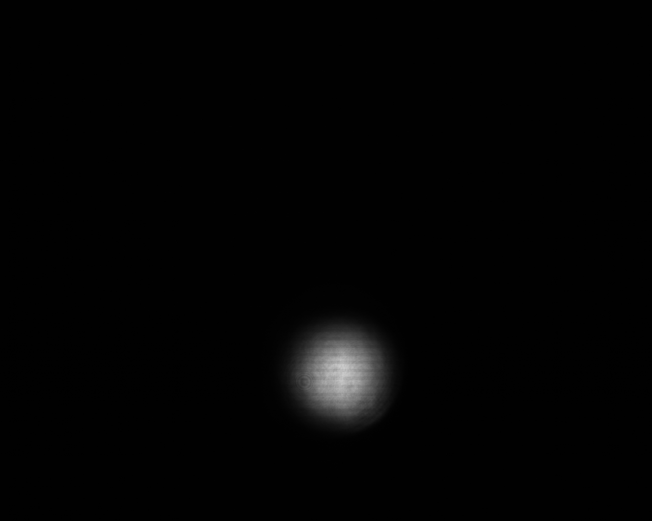
GuideStar Geometry
M0: Dietrich’s motorized mirror
C0: Dietrich’s camera
M1,M2: GuideStar II motorized mirrors
C1,C2: GuideStar II cameras
W: window
SF
C0
M2
W
C1
M0
M1
Ext. Comp.
C2
Cam1
OPA
Cam2

Slide 3
SF
C0
M2
W
C1
M0
M1
Ext. Comp.
C2
Cam1
OPA
Cam2

Slide 4
P
P
1300 iP
G
D65B
WSU501
400 iP
DP₁
P
700 iP
M
DP groove
P
1300 iP
P
T
D65B
WA251
T400i
DP₂
P
400 iP
S
DP groove

